Slide 1


College Management System
|
Moatsem Emam Hussain mahmoud

Slide 2
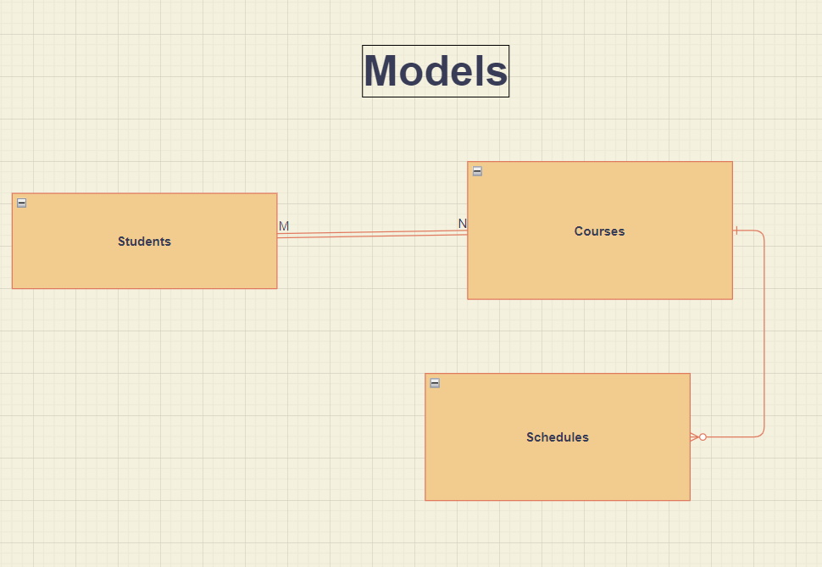

Slide 3
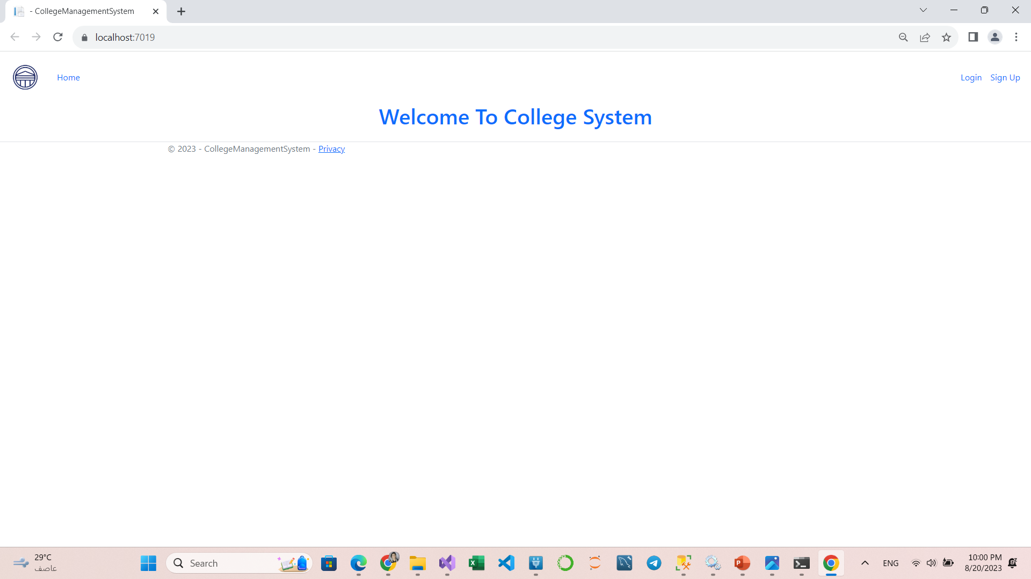
Home Page:
As you can see In the Nav-Bar The Anchors is not available for unauthorized users

Slide 4
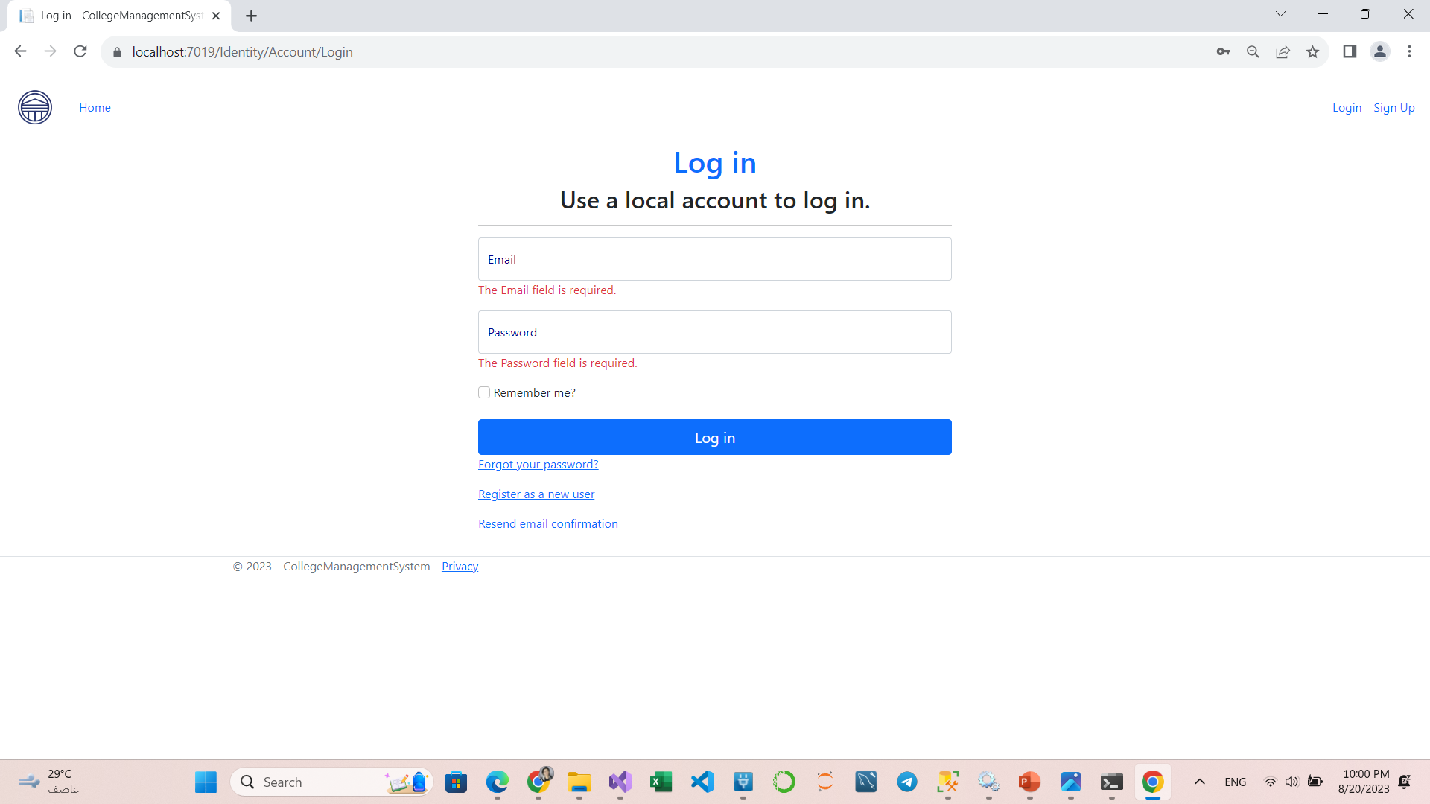
Login Page:

Slide 5
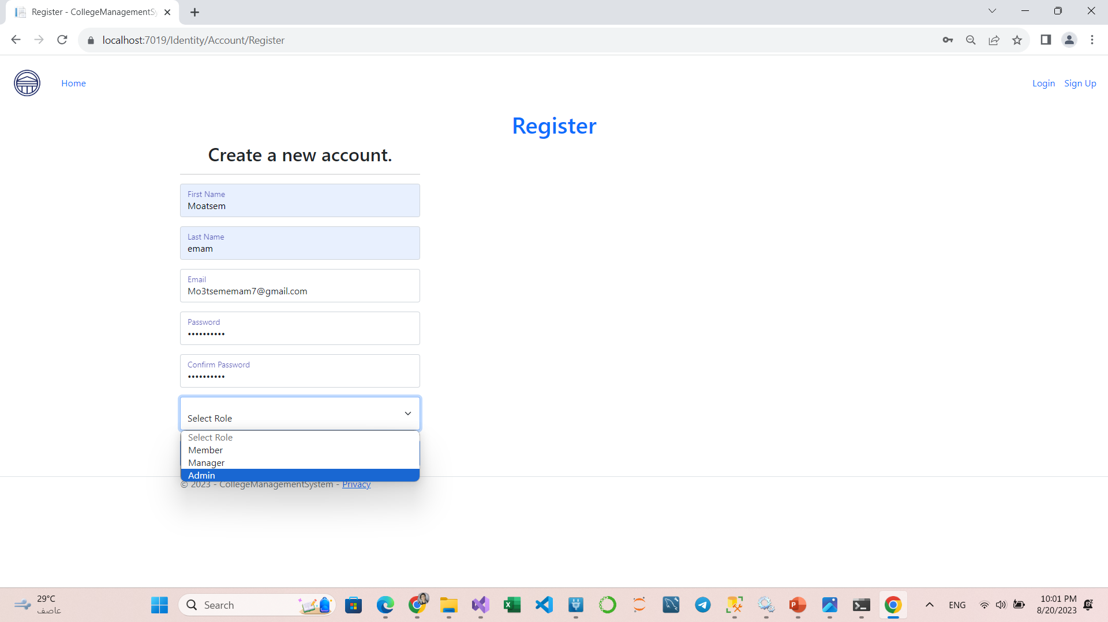
Register Page:
Admins have full control.

Slide 6
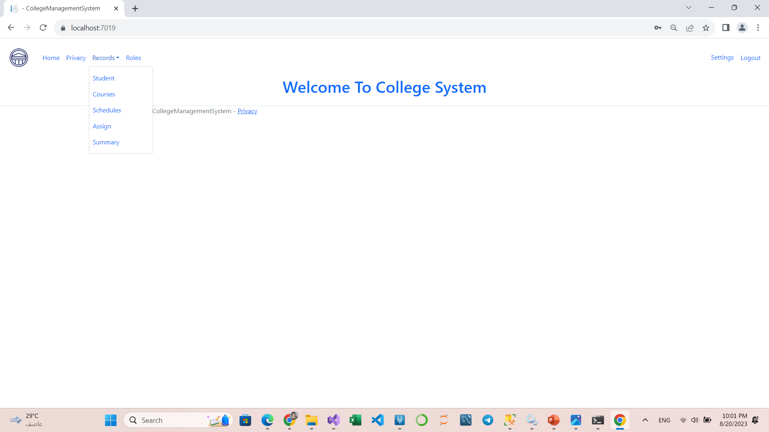
Home Page:
Now We can see the anchors!
You can see the code In the _layout.cshtml Page.

Slide 7
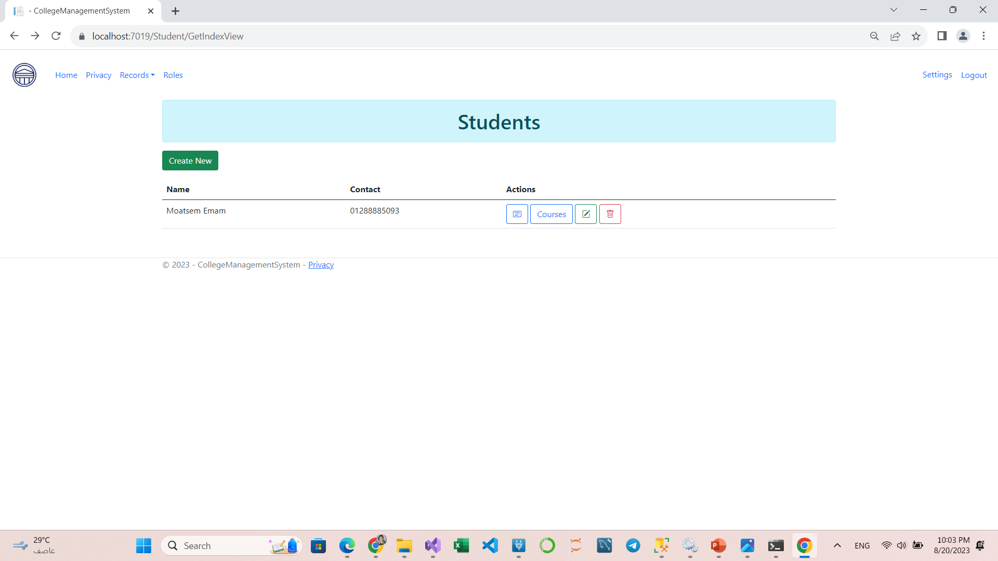
Student Page:
You can Do Crud Operations
Note: Sorry, due to the time I couldn’t handle the delation of students, I hope you can forgive.

Slide 8
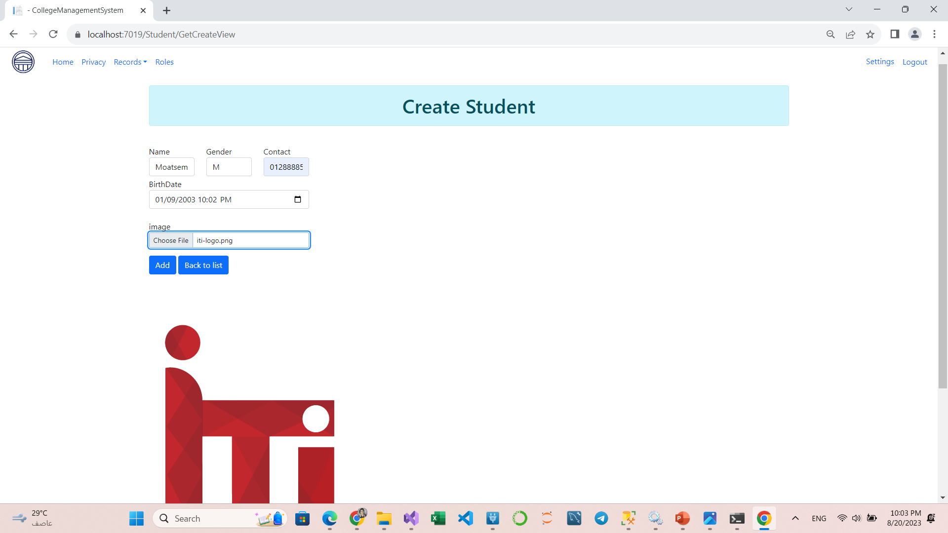
create Page:

Slide 9
Student Data:
insert into students values('Moatsem Emam','M','2003-1-9','01288885093','Null'),('Mohamed Ali','M','2001-8-9','0128845793','Null'),
('Dina Esam','F','2003-4-9','01258248473','Null'),('Aya Mohamed','F','2003-8-2','01288785093','Null'),('Ali Ahmed','M','2002-1-7','01282585093','Null')

Slide 10
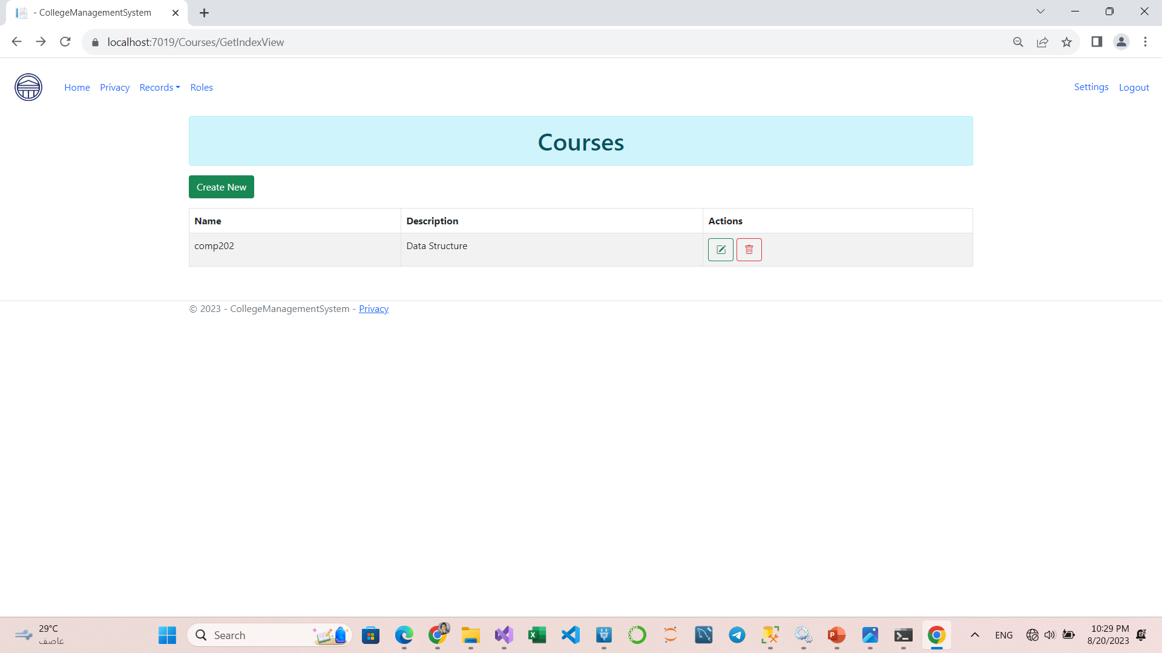
Courses Page:
You can Add, Delete and Edit Course

Slide 11
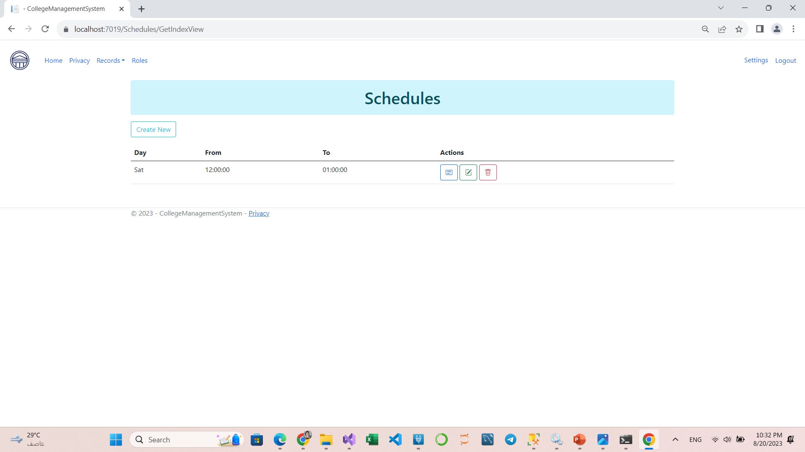
Schedules Page:
You can Add Courses to this Shedule, Delete and Edit Schedule

Slide 12
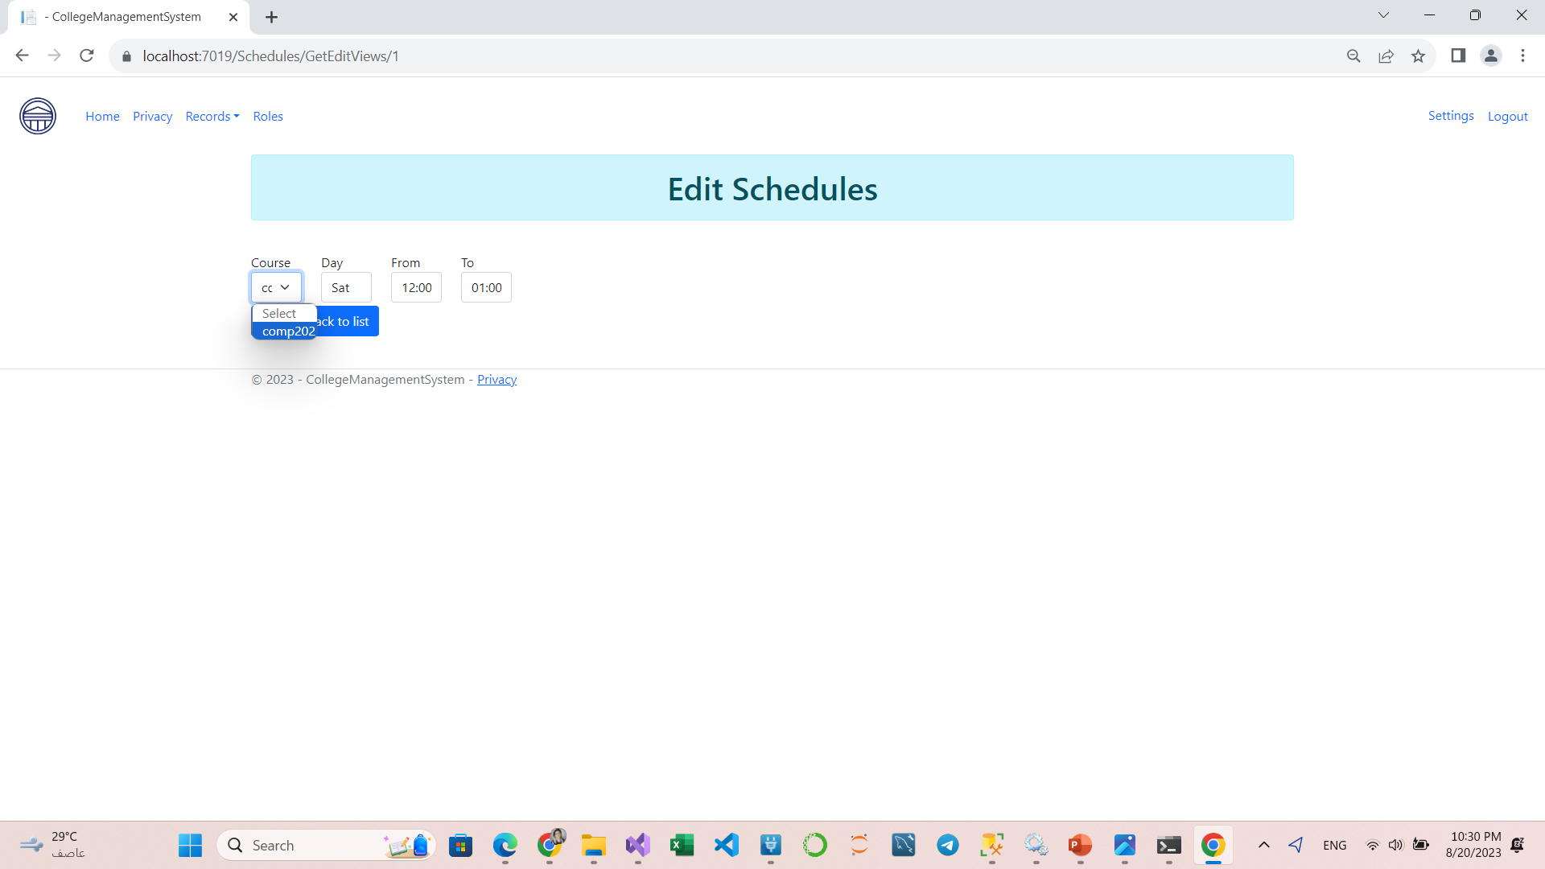
Schedules Page:
You can Add Courses to this Shedule, Delete and Edit Schedule

Slide 13
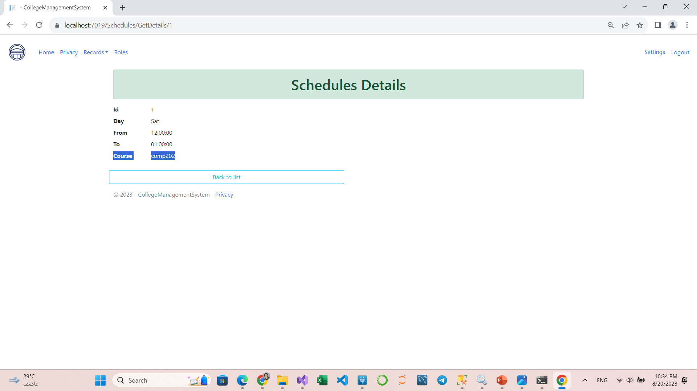
Schedules Page:

Slide 14
Schedules Data:
insert into Courses values ('Comp 201','Algorithms'),('Comp 207','Database'),('Comp 202','Data Structure'),
('Comp 212','OOP'),('Comp 204','Network'),('Comp 206','Web Programming'),
('Stat 201','Statistics Theory 1'),('Stat 303','Operation Research'),('Stat 301','Infarential Statistics'),
('Comp 308','Crypto')

Slide 15
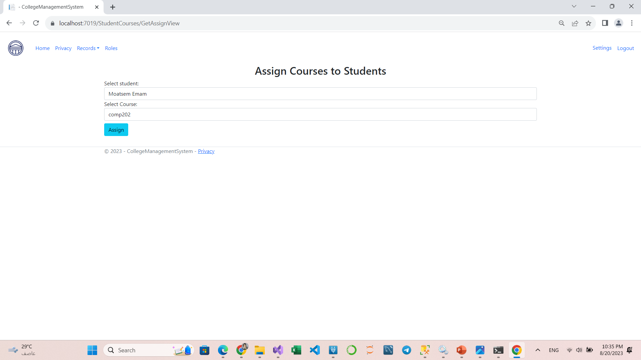
Assign Page:
You can assign courses to students or vise versa as the relationship between the two models is many to many.

Slide 16
Assign Page:
After assigning, the same page redirected with success message, and you can add more.

Slide 17
Schedules Data:
Insert into Schedules values ('Saturday','8:00 AM','10:00 AM'),('Saturday','10:00 AM','12:00 PM'),
('Saturday','1:00 PM','3:00 PM'),('Sunday','8:00 AM','10:00 AM'),('Sunday','10:00 AM','12:00 PM'),
('Sunday','1:00 PM','3:00 PM'),('Tuseday','8:00 AM','10:00 AM'),('Tuseday','10:00 AM','12:00 PM'),
('Tuseday','1:00 PM','3:00 PM'),('Friday','8:00 PM','9:00 PM')

Slide 18
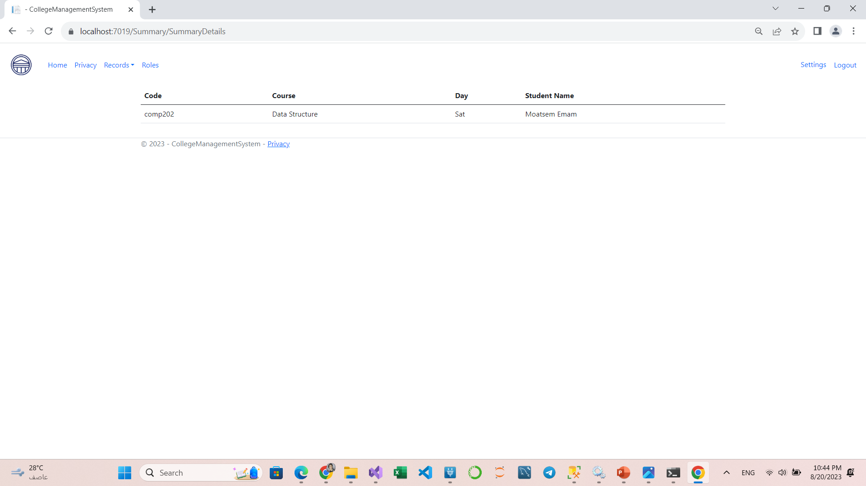
Summary Page:
Finally, You can see the summary of these tables with one hard coded query that i`v provided it in the Summary controller.

Slide 19


